Slide 1

cv
Fake URL Detection using ML & DL
Phase II - Review 1
Team Members
VEDAV K S 1DS19CS187
2. KOUSHIK NAYAK 1DS20CS412
3. KARTHIK V 1DS20CS410
4. A MUKESH 1DS19CS700
Under the Guidance of
Ms Soumya Patil
Assistant Professor, , Dept of Computer Science and Engineering
Department of Computer Science & Engineering, DSCE

Slide 2
cv
INTRODUCTION TO THE PROBLEM:
With the development of Internet technology, network security is under diverse threats. In particular, attackers can spread malicious uniform resource locators (URL) to carry out attacks such as spam and fraud. The research on malicious URL detection is significant for defending against these attacks.
Department of Computer Science & Engineering, DSCE

Slide 3
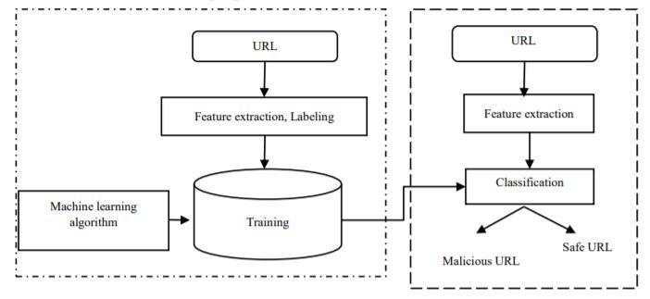
cv
SYSTEM DIAGRAM / ARCHITECTURE:
Department of Computer Science & Engineering, DSCE

Slide 4
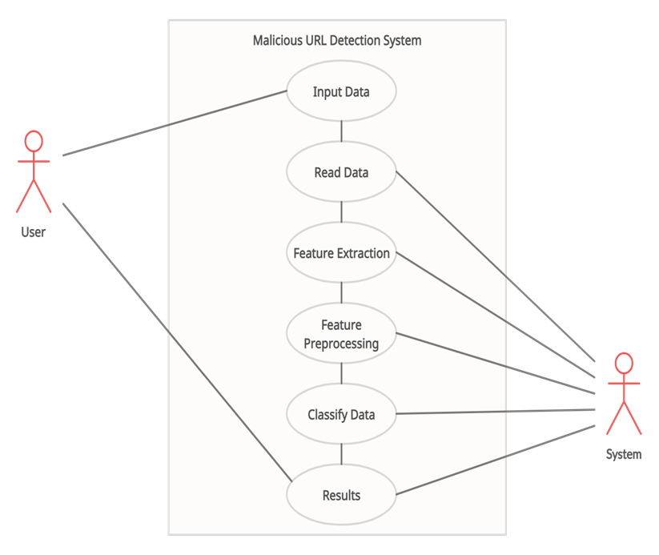
cv
USE CASE DIAGRAM:
Department of Computer Science & Engineering, DSCE

Slide 5
cv
MODULES:
Training stage:-
Data Collection
Feature Extraction
Training of the model
Detection stage:-
Evaluation with testing dataset
Classification
Department of Computer Science & Engineering, DSCE

Slide 6
cv
Modules Descriptions
Training stage:-
Data Collection:- The set of malicious URLs are collected from open source services to train the ML models.
Feature Extraction: In this activity, feature extraction techniques are used to extract Address Bar, domain and HTML & JS based features from URL's.
Training of the model: Part of the Data collected is used for training the Model with different ML techniques.
Detection stage:-
Evaluation with testing dataset:- In this activity, evaluation of the model that is trained is done with the test dataset.
Classification:-The model classifies the testing URL's into safe or malicious URL.
Department of Computer Science & Engineering, DSCE

Slide 7
cv
INPUT:
Data Set:
The dataset contains collection of malicious, benign, spam, malware and defacement URLs in multiple formats like es, JSON, etc
Department of Computer Science & Engineering, DSCE

Slide 8
cv
ALGORITHM:
Step 1: Importing the Dataset
Step 2: Feature Extraction
Step 3: Feature Transformation
Step 4: Creating the Model
Step 5: Training the Model
Step 6: Generating the Predictions
Step 7: Evaluating and comparing the model
Department of Computer Science & Engineering, DSCE

Slide 9
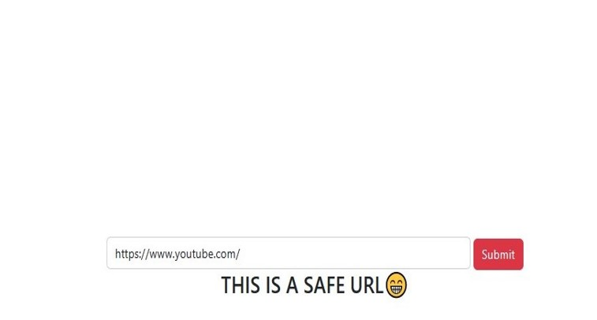
cv
OUTPUT:
Department of Computer Science & Engineering, DSCE

Slide 10
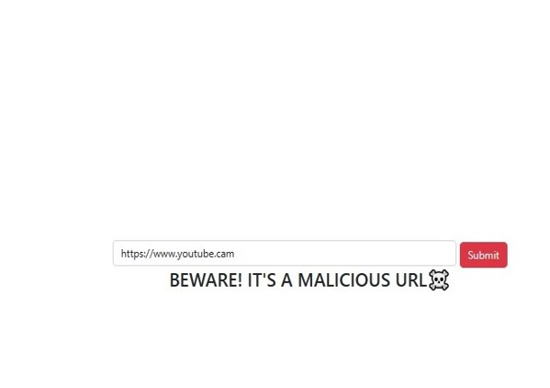
cv
OUTPUT:
Department of Computer Science & Engineering, DSCE

Slide 11
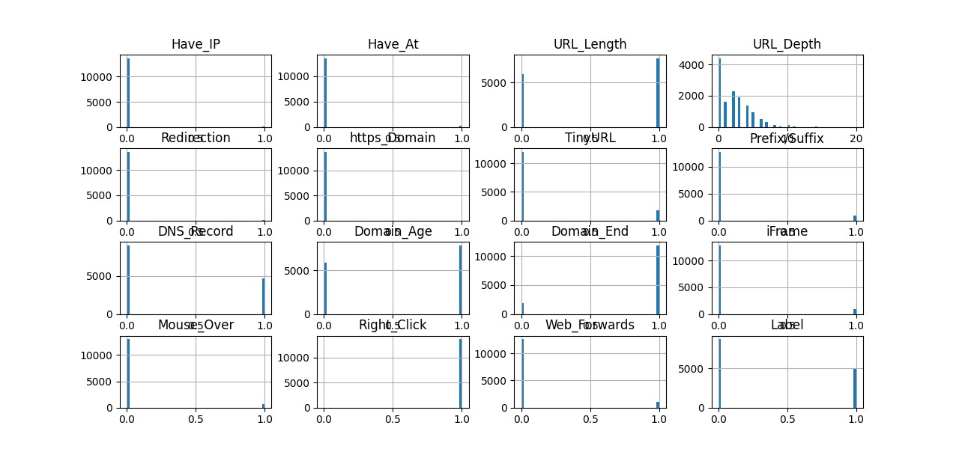
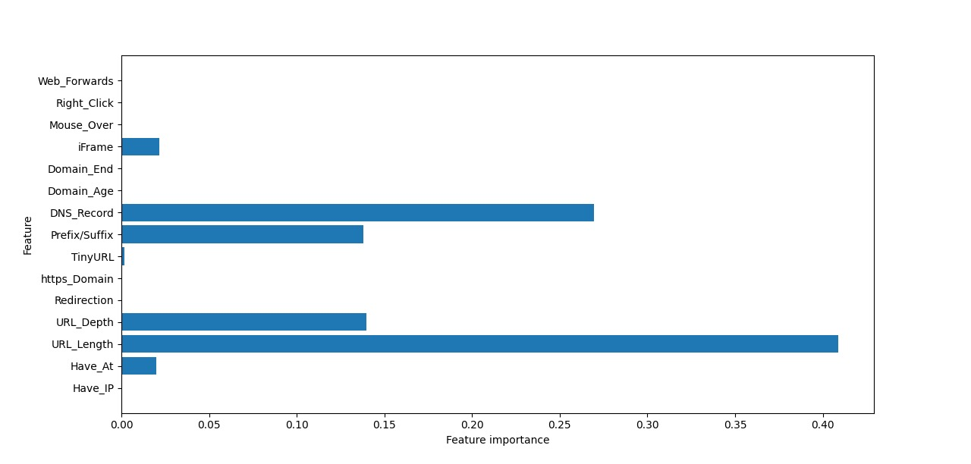
cv
OUTPUT:
Department of Computer Science & Engineering, DSCE

Slide 12

cv
GUI DESIGN:
Department of Computer Science & Engineering, DSCE

Slide 13
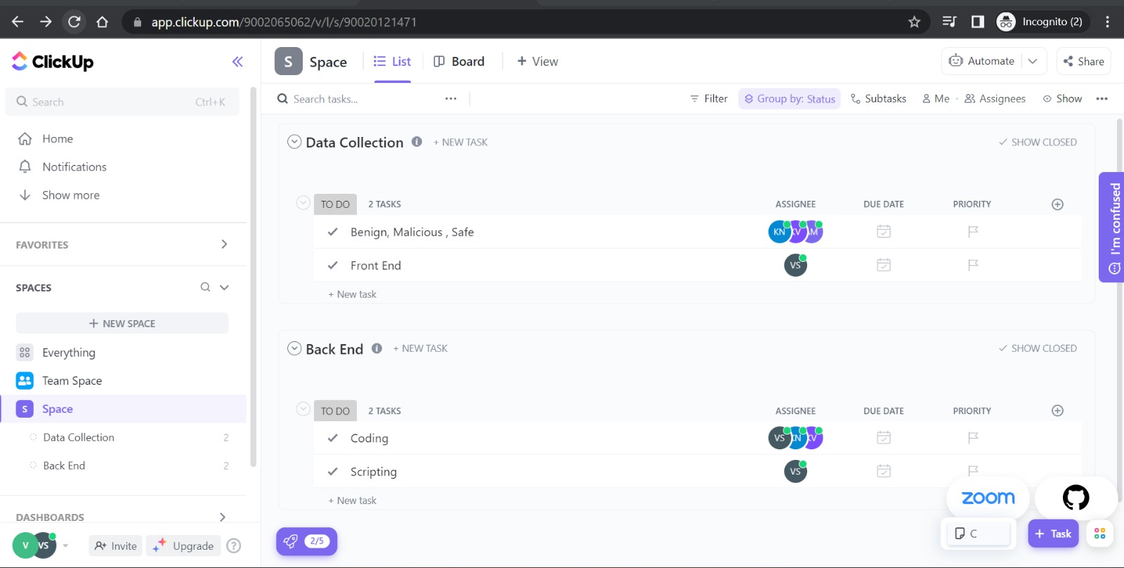
cv
PROJECT TOOL SNAPSHOT:
Department of Computer Science & Engineering, DSCE

Slide 14
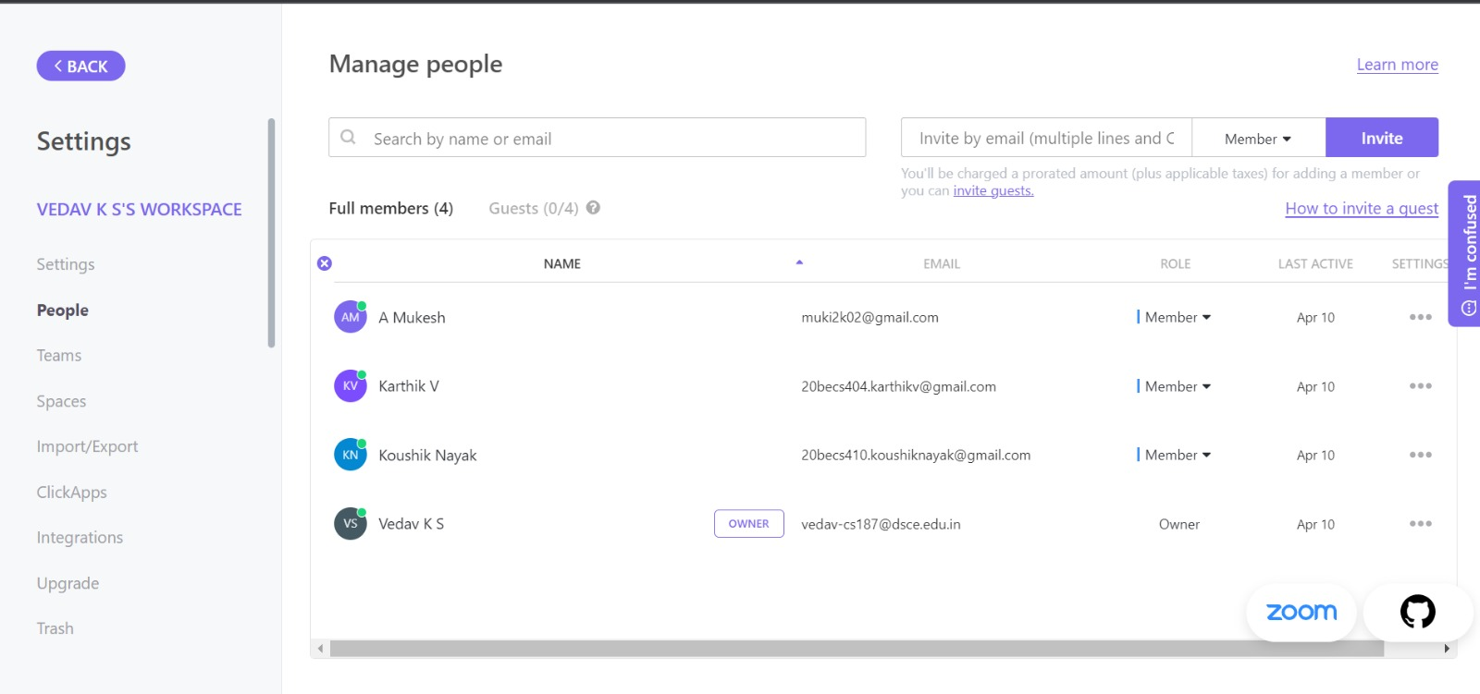
cv
PROJECT TOOL SNAPSHOT:
Department of Computer Science & Engineering, DSCE

Slide 15
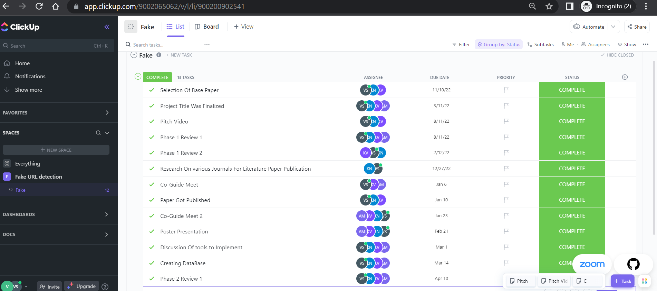
cv
PROJECT TOOL SNAPSHOT:
Department of Computer Science & Engineering, DSCE

Slide 16
cv
THANK YOU!
Department of Computer Science & Engineering, DSCE

